Slide 1
ROBUST BIO-SIGNAL STEGANOGRAPHY WITH LOST-DATA RECOVERY ARCHITECTURE USING DEEP LEARNING
MEMBERS:
EKANATHAN S A (202006018)
SAIVIJAY S (202006038)
RAJASEKAR M (202006253)
GUIDE:

Slide 2
AIM
To perform Robust Bio-Signal Steganography.
To recover the lost data using deep learning architecture.
Notes:
2

Slide 3
OBJECTIVE
To convert the secret information to binary stream for encryption.
To implement Hermite space algorithm.
To obtain best recovery with greater accuracy
Notes:
3

Slide 4
NOVELTY
To forecast both missing secret data and cover signal using deep learning and PSO.
To achieve great fidelity which based on the Hermite polynomial that result in high imperceptibility.
To store the real time data in cloud for further processing.
Notes:
4

Slide 5
LITERATURE SURVEY ROBUST IMAGE STEGANOGRAPHIC SCHEME USING RIWT AND DCT FOR SECURE TRANSMISSION OF MEDICAL IMAGES
ADVANTAGES
Better level of imperceptibility was achieved using SVD and DCT, with embedding carried out on singular values.
Extra security was provided using the logistic chaotic map for encryption of secret medical images, which also enhanced the robustness of the technique
LIMITATIONS
DCT it does not localize the frequency components in space.
SVD-based robust image steganography scheme using RIWT and DCT for secure transmission of medical images

Slide 6
LITERATURE SURVEY SECURING DATA IN INTERNET OF THINGS (IOT) USING CRYPTOGRAPHY AND STEGANOGRAPHY TECHNIQUES
ADVANTAGES
Image steganography has a high capacity to carry secret information as it can hide a large amount of data within an image.
Image steganography provides a covert means of communication, as the existence of the secret message is hidden within the image.
LIMITATIONS
Steganography has a limited capacity for data.
Large overhead to hide very tiny amounts of information.
.
Data in Internet of Things (IoT) using cryptography and steganography techniques

Slide 7
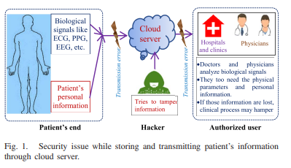


OVERALL BLOCK DIAGRAM
Biological
Signal like
ECG, PPG,
EEG, etc.
Cloud
server
Cloud
server
Transmission error
Transmission error
Hospitals
and Clinics
Physicians
• Doctors and physicians analyze biological signals. • They too need the physical parameters and personal information. • If those information are lost, clinical process may hamper
Patient’s
Personal
information
Tries to tamper
information
Patient’s end
Hacker
Authorized user
﻿Fig. 1. Security issue while storing and transmitting patient's information through cloud server.

Slide 8




BLOCK DIAGRAM
ENCRYPTION: INSERTION OF SECRET BITS
DECRYPTION: EXTRACTION OF SECRET BITS
Secret insertion process
Secret bit extraction process with third block missing
Transmission (with information loss in stego-data)
Bio-signal
n
Reconstructed blocks
B₁
B₂
B₃
B₄
n
Secret bit insertion in Hermite space
`B₁
`B₂
`B₃
`B₄
n
Reconstructed Bio-signal
Passkey
Secret-bit
n
Black feature estimation
BT₁
BT₂
BT₃
BT₄
n
B`₁
B`₂
B`₃
B`₄
n
Secret bit extraction in Hermite space
Su-LSTM
Block feature estimation
Stego-data
Ф[B`₁]
Ф[B`₂]
B`₁
B`₂
?
B`₄
n
PSO-Based
estimation
Ф[B`₃]
$Φ$[B`₁]
$Φ$[B`₂]
$Φ$[B`₃]
$Φ$[B`₄ ]
n
Secret bit
Password
BT₁
BT₂
BT₃
BT₄
n
X1
X2
X3
n-1
X₂
Hidden byte stream

Slide 9
ENCRYPTION: INSERTION OF SECRET BITS

Slide 10
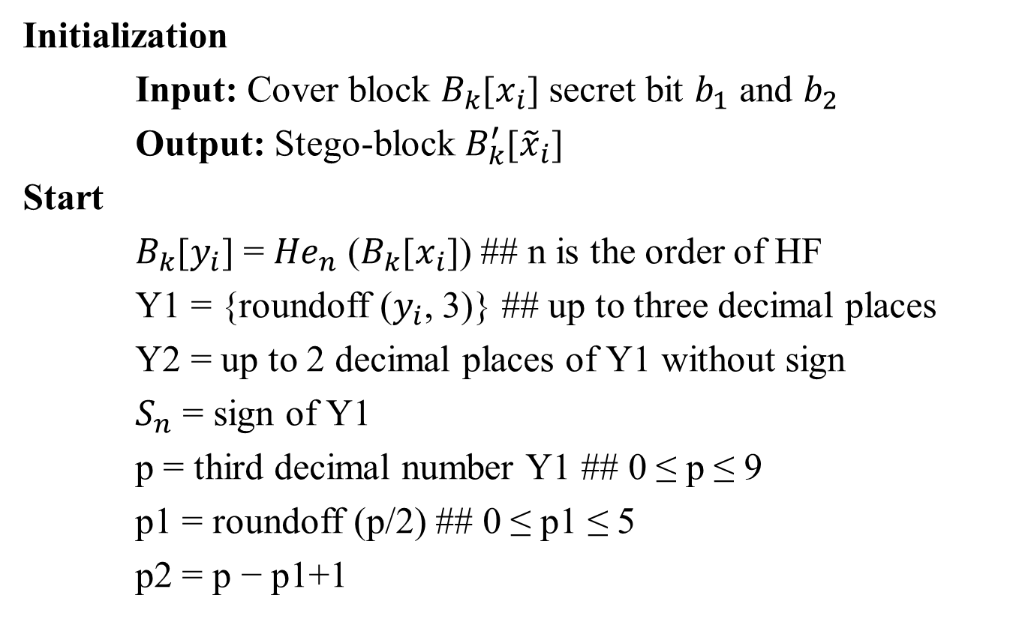
ALGORITHM 1 - Secret Bit Insertion in Hermite Space
Initialization
Input: Cover block $B_{k}$[$x_{i}$] secret bit $b_{1}$ and $b_{2}$
Output: Stego-block $B_{k}^{′}$[${\tilde{x}}_{i}$]
Start
$B_{k}$[$y_{i}$] = ${He}_{n}$ ($B_{k}$[$x_{i}$]) ## n is the order of HF
Y1 = {roundoff ($y_{i}$, 3)} ## up to three decimal places
Y2 = up to 2 decimal places of Y1 without sign
$S_{n}$ = sign of Y1
p = third decimal number Y1 ## 0 ≤ p ≤ 9
p1 = roundoff (p/2) ## 0 ≤ p1 ≤ 5
p2 = p − p1+1

Slide 11

ALGORITHM 1 - Secret Bit Insertion in Hermite Space cont’d..
if $b_{1}$ = = 0 and $b_{2}$ = = 0
$y_{add}$ = 00
$y_{fix}$ = p
else
$y_{add}$= p2 $×$ {($b_{1}×$ 10) + $b_{2}$}
$y_{fix}$ = p1
${\tilde{y}}_{i}$ = $S_{n}×$ {(Y2) + ($y_{fix}×{10}^{−3}$) + ($y_{add}×{10}^{−5}$)}
$B_{k}^{′}$[${\tilde{x}}_{i}$] = ${He}_{n}^{−1}$($B_{k}$[${\tilde{y}}_{i}$])
End

Slide 12
DECRYPTION: EXTRACTION OF SECRET BITS

Slide 13
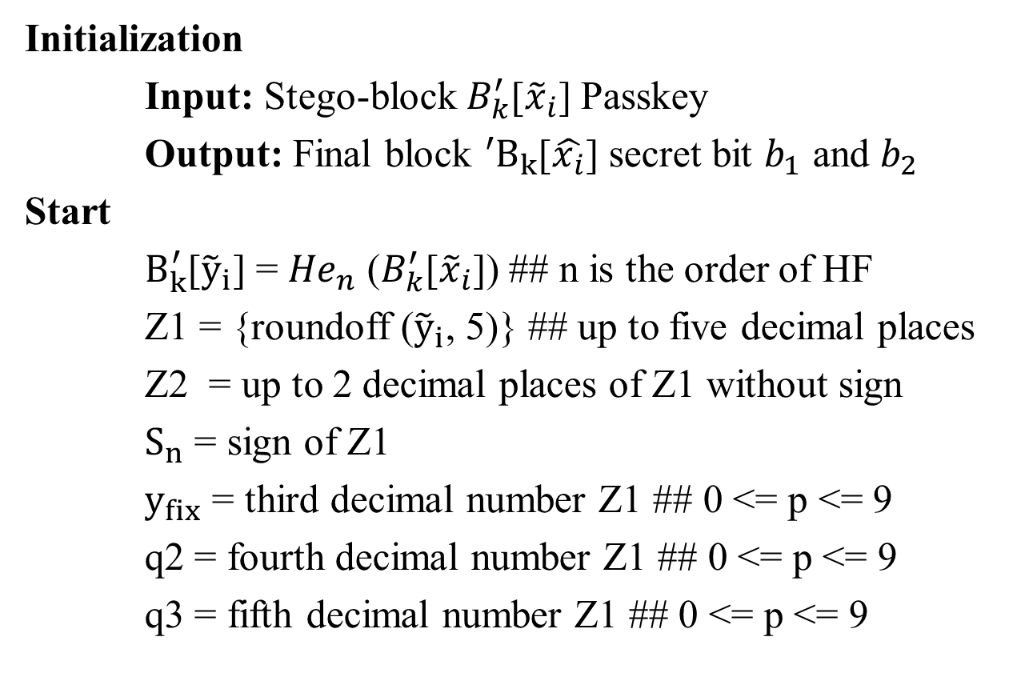
ALGORITHM 2 - Secret Bit Extraction in Hermite Space
Initialization
Input: Stego-block${ B}_{k}^{′}$[${\tilde{x}}_{i}$] Passkey
Output: Final block ${{}_{ }^{′}B}_{k}$[$\hat{x_{i}}$] secret bit $b_{1}$ and $b_{2}$
Start
$B_{k}^{′}$[${\tilde{y}}_{i}$] = ${He}_{n}$ ($B_{k}^{′}$[${\tilde{x}}_{i}$]) ## n is the order of HF
Z1 = {roundoff (${\tilde{y}}_{i}$, 5)} ## up to five decimal places
Z2 = up to 2 decimal places of Z1 without sign
$S_{n}$ = sign of Z1
$y_{fix}$ = third decimal number Z1 ## 0 <= p <= 9
q2 = fourth decimal number Z1 ## 0 <= p <= 9
q3 = fifth decimal number Z1 ## 0 <= p <= 9

Slide 14
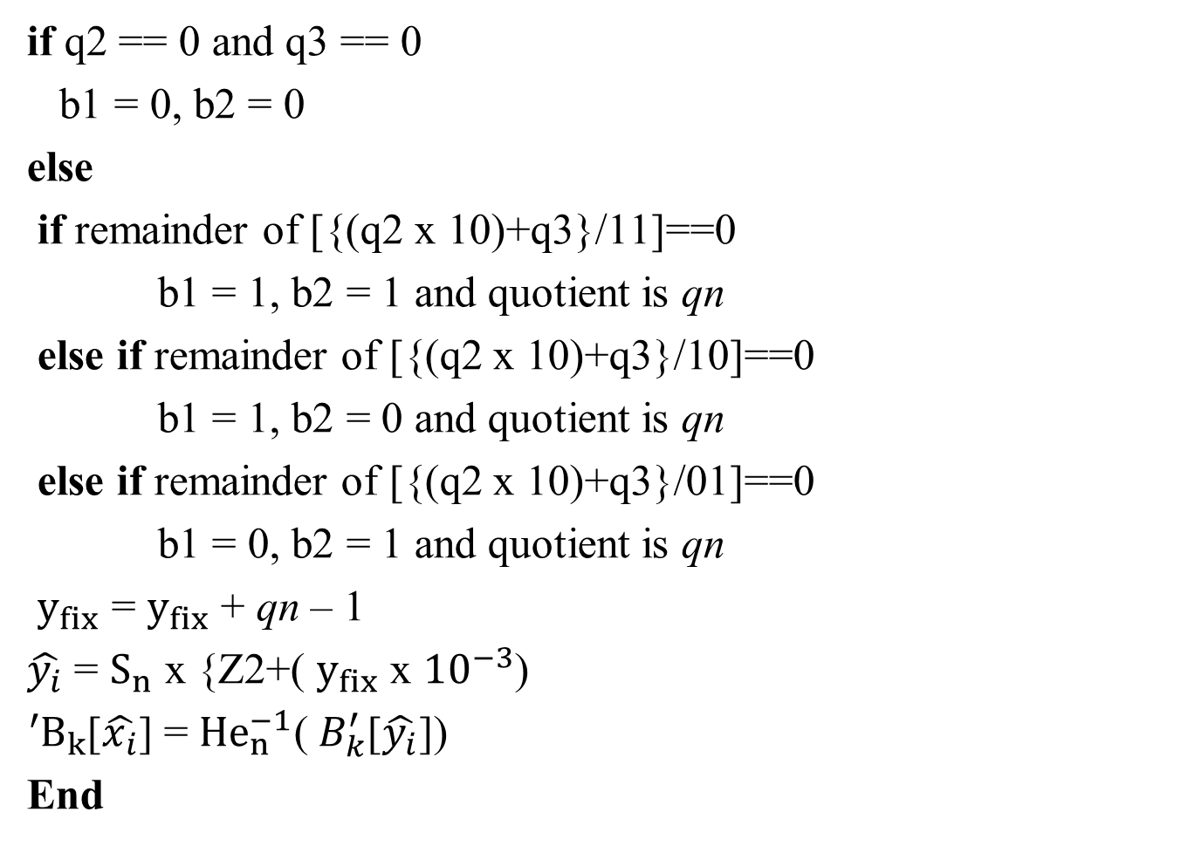
cont’d..
if q2 == 0 and q3 == 0
b1 = 0, b2 = 0
else
if remainder of [{(q2 x 10)+q3}/11]==0
b1 = 1, b2 = 1 and quotient is qn
else if remainder of [{(q2 x 10)+q3}/10]==0
b1 = 1, b2 = 0 and quotient is qn
else if remainder of [{(q2 x 10)+q3}/01]==0
b1 = 0, b2 = 1 and quotient is qn
$y_{fix}$ = $y_{fix}$ + qn – 1
$\hat{y_{i}}$ = $S_{n}$ x {Z2+( $y_{fix}$ x ${10}^{−3}$)
${{}_{ }^{′}B}_{k}$[$\hat{x_{i}}$] = ${He}_{n}^{−1}$(${ B}_{k}^{′}$[$\hat{y_{i}}$])
End

Slide 15
MISSING BYTE AND BLOCK FEATURE ESTIMATION BY PSO

Slide 16
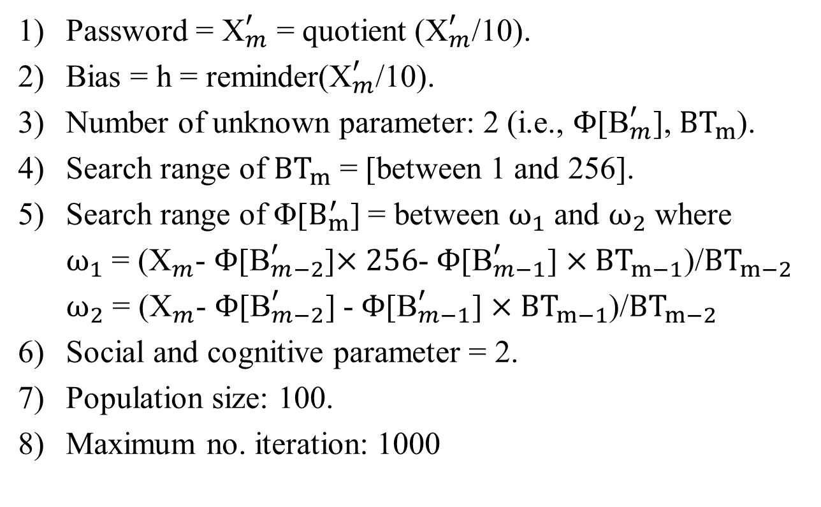
PSO algorithm
Password = ${\text{X}}_{m}^{′}$= quotient (${\text{X}}_{m}^{′}$/10).
Bias = h = reminder(${\text{X}}_{m}^{′}$/10).
Number of unknown parameter: 2 (i.e., $Φ$[${\text{B}}_{m}^{′}$], ${BT}_{m}$).
Search range of ${BT}_{m}$ = [between 1 and 256].
Search range of Φ[$B_{m}^{′}$] = between $ω_{1}$ and $ω_{2}$ where
$ω_{1}$ = (${\text{X}}_{m}^{ }$-$Φ$[${\text{B}}_{m−2}^{′}$]$×256$-$Φ$[${\text{B}}_{m−1}^{′}$]$×{BT}_{m−1}$)/${BT}_{m−2}$
$ω_{2}$ = (${\text{X}}_{m}^{ }$-$Φ$[${\text{B}}_{m−2}^{′}$] -$Φ$[${\text{B}}_{m−1}^{′}$]$×{BT}_{m−1}$)/${BT}_{m−2}$
Social and cognitive parameter = 2.
Population size: 100.
Maximum no. iteration: 1000

Slide 17
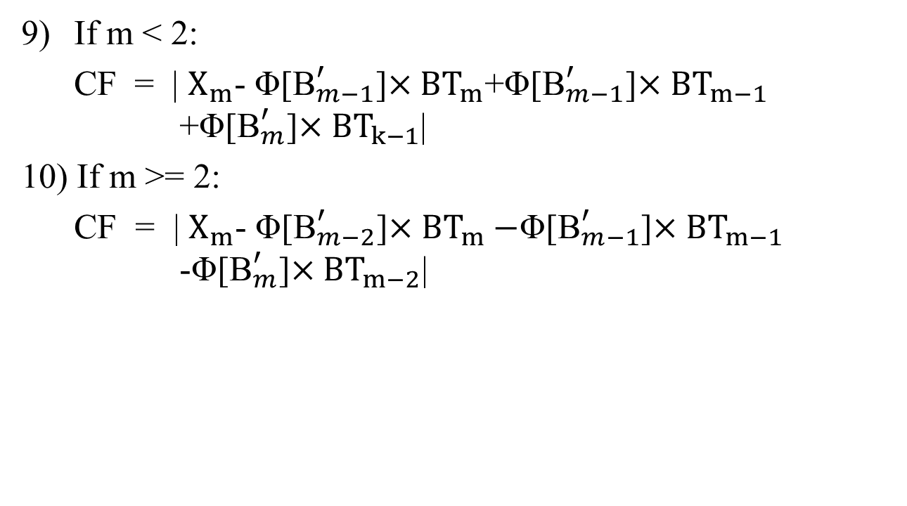
PSO algorithm cont’d…
If m < 2:
CF = | $X_{m}$- Φ[${\text{B}}_{m−1}^{′}$]$×{BT}_{m}$+Φ[${\text{B}}_{m−1}^{′}$]$×{BT}_{m−1}$ +Φ[${\text{B}}_{m}^{′}$]$×{BT}_{k−1}$|
10) If m >= 2:
CF = | $X_{m}$- Φ[${\text{B}}_{m−2}^{′}$]$×{BT}_{m}−$Φ[${\text{B}}_{m−1}^{′}$]$×{BT}_{m−1}$-Φ[${\text{B}}_{m}^{′}$]$×{BT}_{m−2}$|

Slide 18
PREDICTION OF LOST STEGO-BLOCK USING SU-LSTM

Slide 19
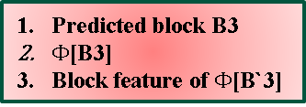
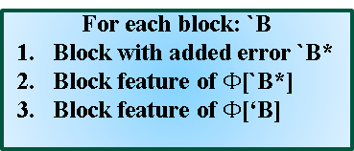

Training
Testing
`B₁
`B₂
`B₃
`B₄
n
Output data from Su-LSTM
Reference data
For each block: `B
Block with added error `B*
Block feature of $Φ$[`B*]
Block feature of $Φ$[‘B]
C_{t-1}
C_{t}
tanh
Input layer
V_{t-1}
F
F
F
F
U_{t}
_{Vt}
MLPNN
LSTM
Input data
B₃
Output from LSTM
Predicted block B3
$Φ$[B3]
Block feature of $Φ$[B`3]
$Φ$[B`₃]
Output from PSO
Fig. 3. Architecture of Su-LSTM network

Slide 20
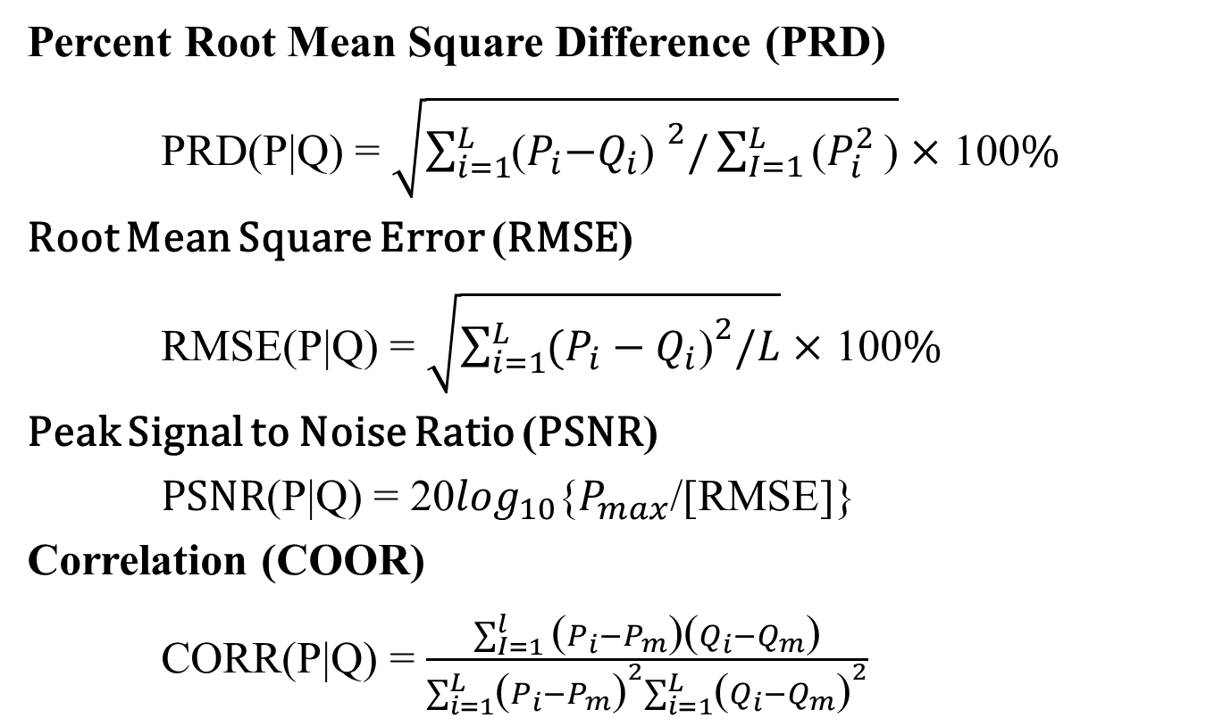
PERFORMANCE INDICES
Percent Root Mean Square Difference (PRD)
PRD(P|Q) = $\sqrt{\sum_{i=1}^{L}{{\text{(}P_{i}\text{−}Q_{i}\text{) }}^{2}/\sum_{I=1}^{L}{\text{(}P_{i}^{2}}}\text{)}}×$ 100%
Root Mean Square Error (RMSE)
RMSE(P|Q) = $\sqrt{\sum_{i=1}^{L}{{(P_{i}−Q_{i}\text{)}}^{2}/L}}×$ 100%
Peak Signal to Noise Ratio (PSNR)
PSNR(P|Q) = 20$\log_{10}${$P_{max}$/[RMSE]}
Correlation (COOR)
CORR(P|Q) = $\frac{\sum_{I=1}^{l}{\text{(}P_{i}−P_{m}\text{)(}Q_{i}−Q_{m}\text{)}}}{\sum_{i=1}^{L}{{\text{(}P_{i}−P_{m}\text{)}}^{2}\sum_{i=1}^{L}{{\text{(}Q_{i}−Q_{m}\text{)}}^{2}}}}$

Slide 21
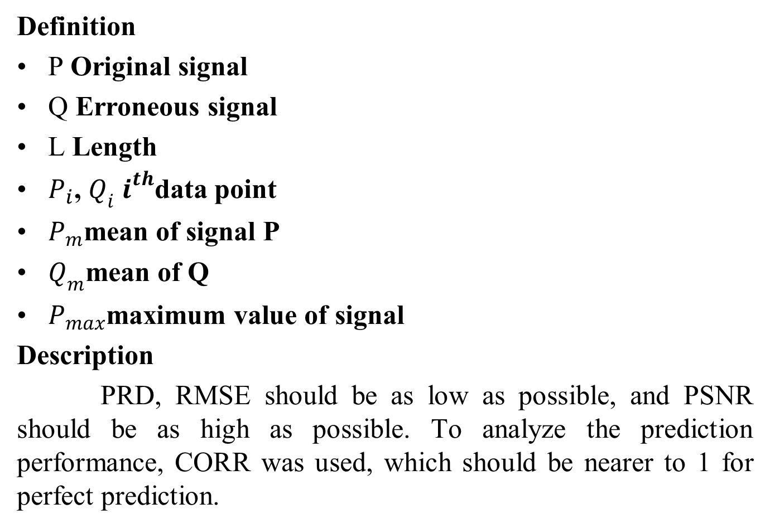
PERFORMANCE INDICES
Definition
P Original signal
Q Erroneous signal
L Length
$P_{i}$, $Q_{i}i^{th}$data point
$P_{m}$mean of signal P
$Q_{m}$mean of Q
$P_{max}$maximum value of signal
Description
PRD, RMSE should be as low as possible, and PSNR should be as high as possible. To analyze the prediction performance, CORR was used, which should be nearer to 1 for perfect prediction.

Slide 22
DATA SET
MIT-BIH arrhythmia
DATA SETS\100.dat
BIDMC PPG records
DATA SETS\bidmc_01_Signals.csv
RSVP tasks
DATA SETS\rsvp_10Hz_02a.edf

Slide 23
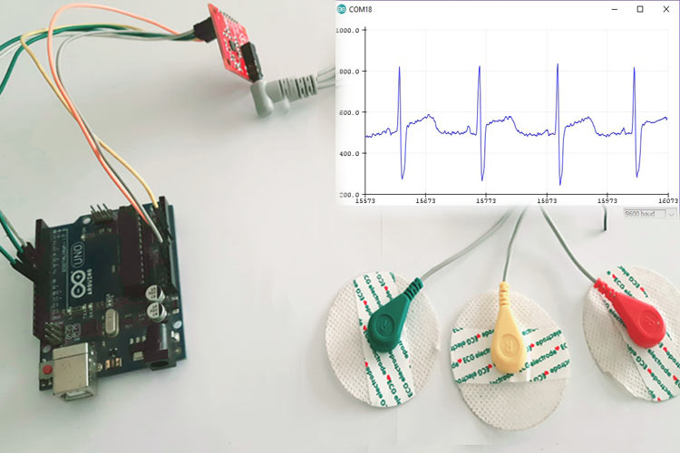
HARDWARE SETUP

Slide 24
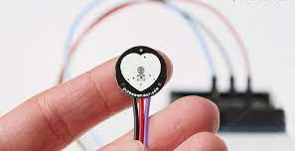
HARDWARE SETUP
PPG SIGNAL SENSOR

Slide 25
References
[1] S. Arunkumar, V. Subramaniyaswamy, V. Vijayakumar, N. Chilamkurti, and R. Logesh, “SVD-based robust image steganographic scheme using RIWT and DCT for secure transmission of medical images,” Measurement, vol. 139, pp. 426–437, Jun. 2019.
[2] A. S. Sangari and J. M. L. Manickam, “Public key cryptosystem based security in wireless body area network,” in Proc. Int. Conf. Circuits, Power Comput. Technol. (ICCPCT), Mar. 2014, pp. 1609–1612.
[3] S. E. Jero, P. Ramu, and S. Ramakrishnan, “Discrete wavelet transform and singular value decomposition based ECG steganography for secured patient information transmission,” J. Med. Syst., vol. 38, no. 10, pp. 1–11, Oct. 2014.
[4] N. Soni, I. Saini, and B. Singh, “An integer wavelet transform and pixel value differencing based feature specific hybrid technique for 2D ECG steganography with high payload capacity,” Multim. Tools Appl., vol. 80, pp. 8505–8540, Mar. 2021.

Slide 26
THANK YOU
Notes:
26

